Slide 1



Testing
Nitin Kumar Gaur
Emp Id : 6168
Batch : 89
Date : 23/09/2021

Slide 2
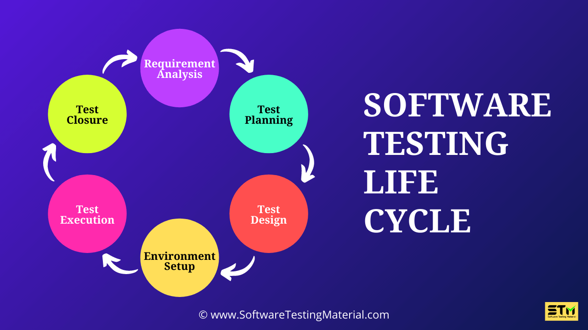
Testing life cycle
sequence of specific actions performed during the testing process comes with STLC.
Its help to met the SRS objective
Its include both Verification and Validation.
Scr: softwaretestingmaterial.com

Slide 3
Objective of Writing Test Cases
To validate specific features and functions of the software.
To guide testers through their day-to-day hands-on activity.
To record a catalog of steps undertaken, which can be revisited in the event of a bug popping up.
To provide a blueprint for future projects and testers so that they don’t have to start work from scratch.
To help detect usability issues and design gaps early on.
To help new testers quickly pick up testing, even if they join in the middle of an ongoing project.

Slide 4







Standard Test Case Format
Test id: 0101
Test Case ID
Test Scenario
Test Steps
Prerequisites
Test Data
Expected/Intended Results
Actual Results
Test Status – Pass/Fail
Define test scenario
Define each step
Test data
Actual test result
Expected test result
NO
Yes/no
YES
Accepted/pass

Slide 5
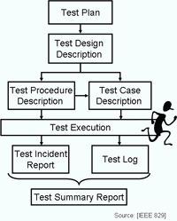
While writing test cases, remember to include
These points
A reasonable description of the requirement
A description of the test process
Details related to test setup: version of the software under test, data points, OS, hardware, security clearance, date, time, prerequisites, etc.
Any related documents or attachments testers will require
Scr IEEE

Slide 6
Sample of a basic testing process
Test Case Example
Let’s build a test case example based on a specific scenario. Here is a sample case.
Test Case ID: #BST001
Test Scenario: To authenticate a successful user login on Gmail.com
Test Steps:
The user navigates to Gmail.com.
In the ’email’ field, the user enters a registered email address.
The user clicks the ‘Next’ button.
The user enters the registered password.
The user clicks ‘Sign In.’
Prerequisites: A registered Gmail ID with a unique username and password.
Browser: Chrome v 86. Device: Samsung Galaxy Tab S7.
Test Data: Legitimate username and password.
Expected/Intended Results: Once username and password are entered, the web page redirects to the user’s inbox, displaying and highlighting new emails at the top.
Actual Results: As Expected
Test Status – Pass/Fail: Pass

Slide 7













